Slide 1
Space Mission 2010/Jupiter
Made by the partnership of Darian Palacios and Liana Deng

Slide 2
Jupiter’s size
Jupiter is 88,850 miles in diameter.
Jupiter IS 317X as big as the earth.
It is the biggest planet in the whole Solar System!
Jupiter has almost invisible rings made of specks of dust.

Slide 3

Location
Jupiter is the fifth planet.
It is 484 million miles from the sun on average.
It takes twelve years to orbit the sun.
It takes six years to fly to Jupiter from Earth.

Slide 4
Temperature
-262* to -186*F
Powerful storms with a result of lightning from condensation and evaporation
Jupiter’s core is so hot that it gives off more heat than it receives from the sun.
If Jupiter got any hotter it would become our second sun.

Slide 5

Atmosphere
Way thicker that the Earth
Made of Hydrogen and Helium
In the middle contains fluids

Slide 6
Fun Facts!!
A day on Jupiter is only 10 hours!
The Great Red Spot is 4x wider than the Earth. WOW!!
The Great Red Spot is a storm cloud that has been raging for over 320 years.
Jupiter’s magnetic field is 20,000x stronger than the Earth’s.
Jupiter has over 60 known moons.

Slide 7
Our Mission
Destination: Jupiter
We are going to orbit Jupiter.
We are going to take photographs of Jupiter.

Slide 8

Quiz!
Now to make sure you were paying attention….

Slide 9

Question #1
How many Jupiter moons are there?
A. more than 60
B. 39
C. None

Slide 10

Answer!!
A!

Slide 11
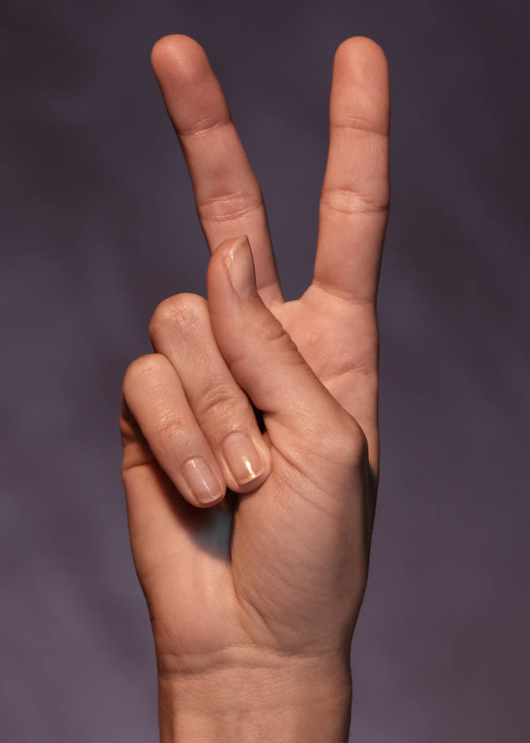
Question #2
How big is the Great Red Spot?
A. 3,000 miles
B. 4x wider than the Earth
C. as big as Saturn

Slide 12
Answer!
B!

Slide 13
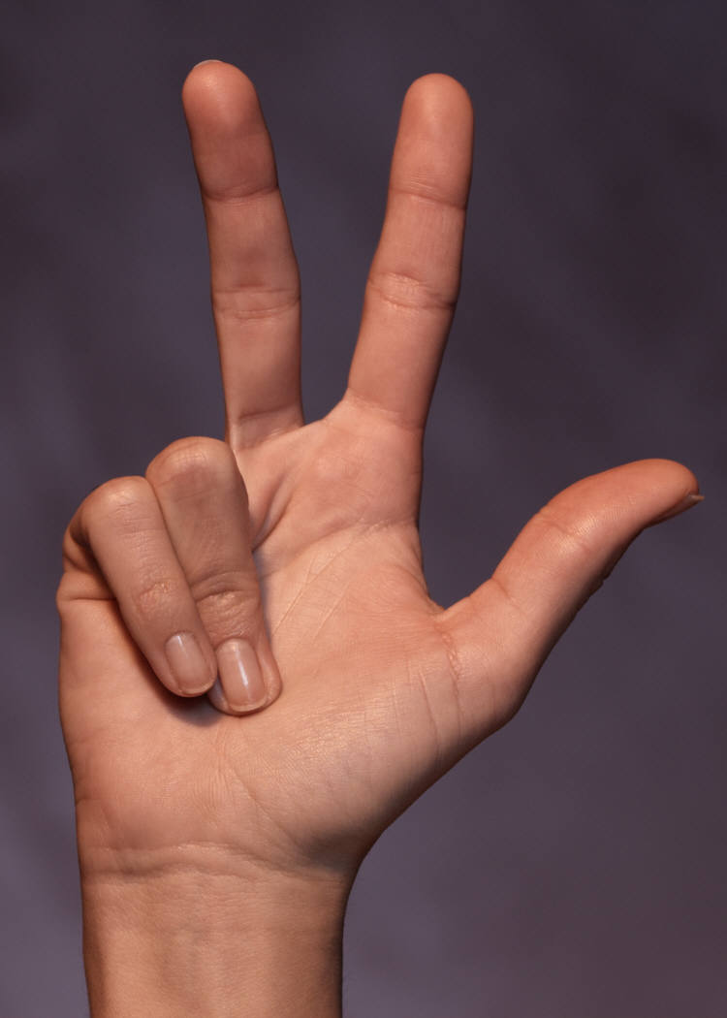
Question #3
If Jupiter got any hotter what would happen?
A.be second sun
B. blow up
C. Change Colors

Slide 14
Answer!
A!

Slide 15


Thanks for waTCHING!!!

